Slide 1
MM Designs

Slide 2
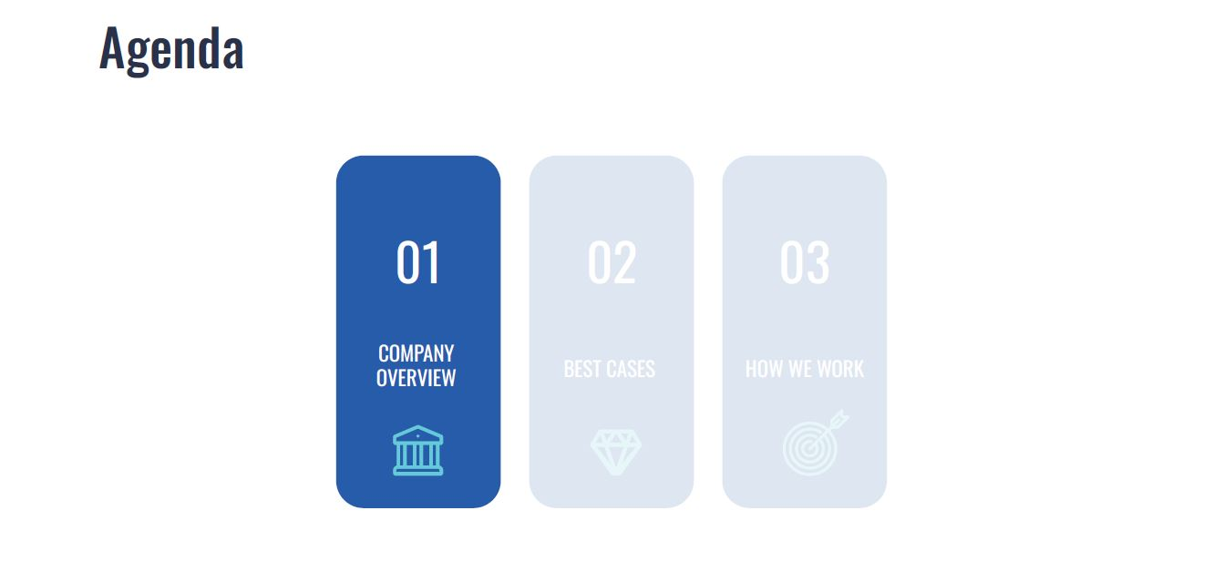

Slide 3
About MM Designs
MM Designs was founded in 2018 and has grown every year with an exceptional team that has delivered over 50+ projects.
We are proud of the quality of our work, client satisfaction and ROI.
We are recognised by Design Rush, an independent review platform as one of the top agencies in London

Slide 5
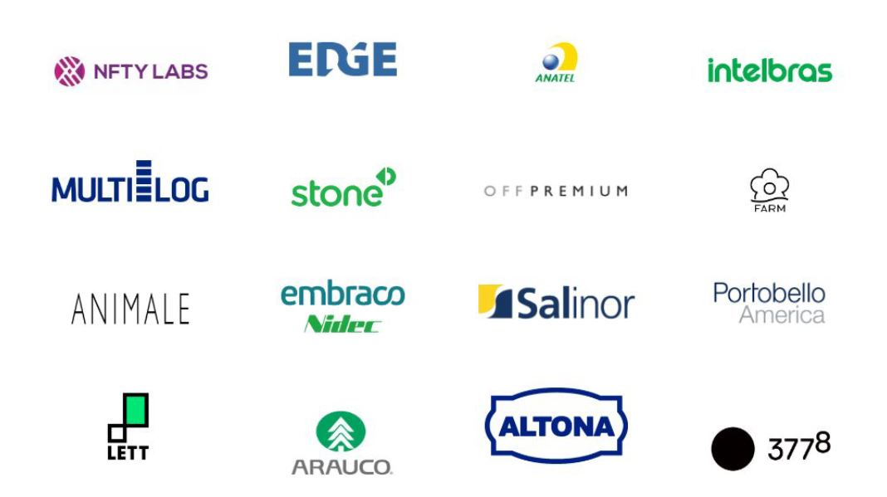
Startups & industry leaders trust our experts

Slide 6
We work with top performance tools

Slide 9
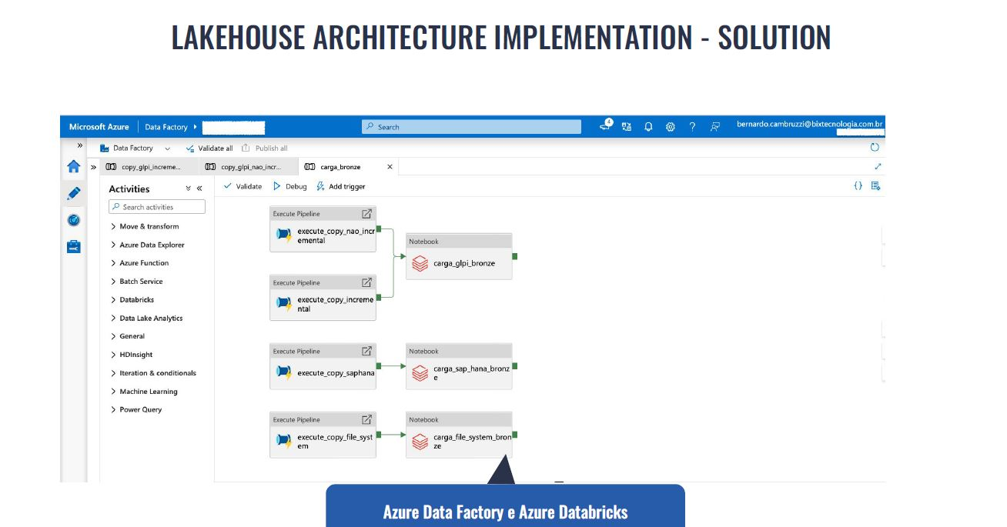

Slide 17
Thank You!
Majed Mahmood
CEO/Founder MM Designs
hello@mmdesignsldn.com
07400909884

